Slide 1

Expression Atlas update :from tissues to single cells
Abstract PPT
한국뇌연구원 신경유전학 Lab

Slide 2
Introduction
Expression Atlas
Single cell Expression Atlas
Future Directions

Slide 3

Introduction
The European Bioinformatics Institute (EMBL-EBI) is an International Governmental Organization (IGO) which, as part of the European Molecular Biology Laboratory (EMBL) family, focuses on research and services in bioinformatics.
출처: https://en.wikipedia.org/wiki/European_Bioinformatics_Institute
Expression Atlas
Single Cell Expression Atlas
Launched
2009
2018
Expression Atlas is EMBL-EBI's resource for gene and protein expression in various biological systems and contexts and provides open access to this data for the research community

Slide 4

Expression Atlas
Expression Atlas is an added-value online bioinformatics resurce that includes a database, user interface and web-service enabling easy access to information about gene epression across species, tissues, cells experimental conditions and diseases
Datasets
NCBI's Gene Expression Omnibus (GEO)
European Nucleotide Archive
GTEx
Gramene
Pancancer Analysis of Whole Genomes (PCAWG)
Protein expression information datasets
PRIDE
Human Protein Atlas
Gene Expression datasets
Open Targets

Slide 5

Single Cell Expression Atlas
Single Cell Expression Atlas includes 123 studies, including almost a million assays from 12 different species.
It enables to providing easy input to software for further analysis gene of expression matrices, as well as supporting the development of computational methods for downstream analyses
Datasets
: All datasets are sourced from public archives
Array Express and GEO
Experimental Factor Ontology terms (EFO)
Cell Ontology
Data analysis
Gene expression quantification
: The pipline comprises quality filtering, quality trimming and sequencing artifact removal with FASTX-Toolkit, poly-A and uncalled base filtering with fastq-utils and contamination check. And so on.
Downstream analysis
: Final output files are provided in standard file formats where availabe, including a 10x-like matrix market format for expression matrices.

Slide 6
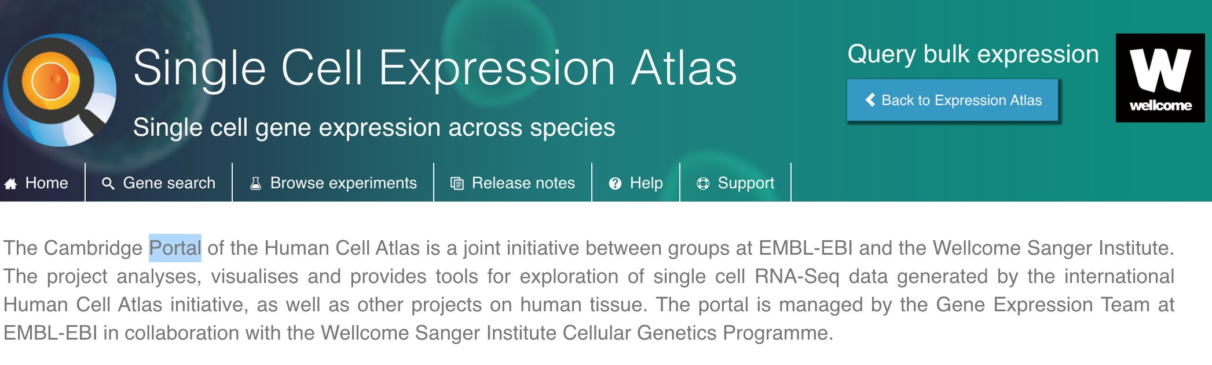
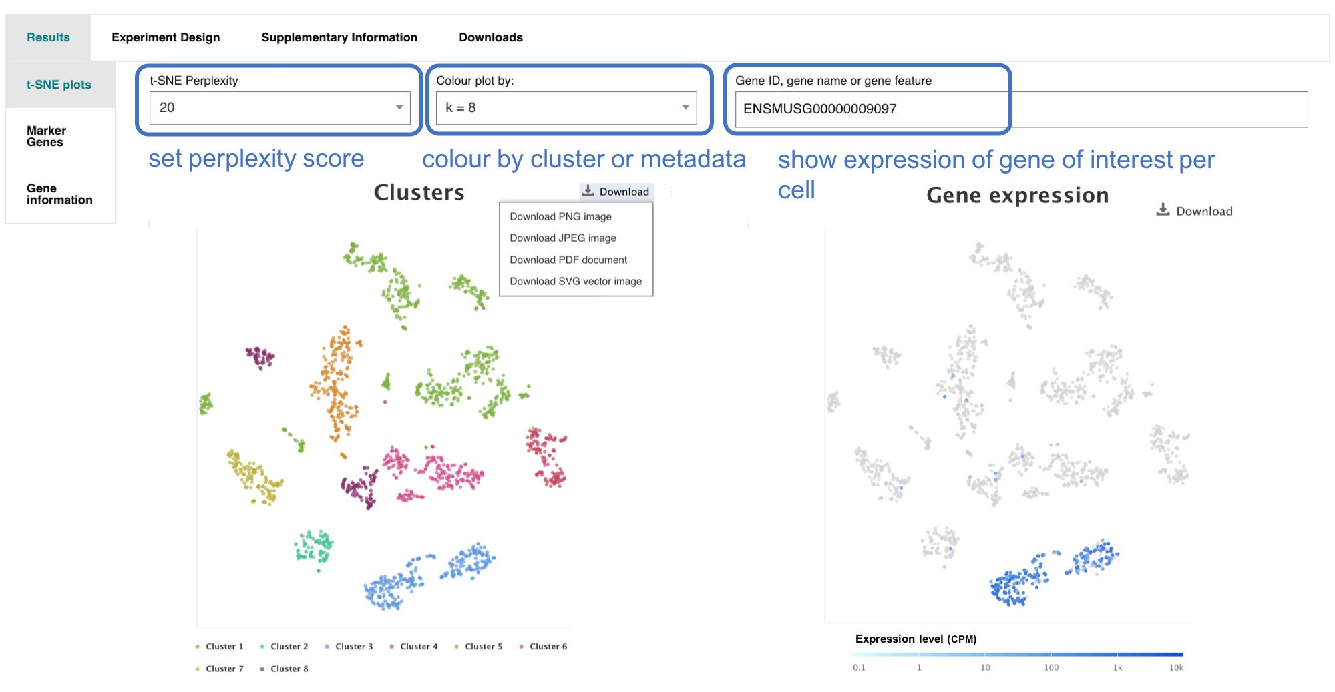
Single Cell Expression Atlas
User interface
The website can be searched by genes within or across species to reveal expreiments, tissues and cell types where this gene is expressed or under which conditions it is a marker gene.
Cells can be visulized using a pre-calculated t-SNE plot and can be clolured by different metadata or by cell clusters, based on gene expression
Gene search
t-SNE
출처: https://pbs.twimg.com/media/EUV57v4WoAI1Loy?format=jpg&name=4096x4096
https://twitter.com/ExpressionAtlas/status/1189982896825782273

Slide 7
Future Directions
The Expression Atlas intergrated data from multiple datasets, in a single interface and processed in a uniform way
We will continue to develop Single Cell Expression Atlas and will focus on combining the precision of gene expression at the single cell level to the breadth of gene expression across a variety of conditions and tissues within the main components of Expression Atlas.
We will explore possibilities to provide a wider range of data visualization rather than t-SNE plots, including UMAP or PCA to name a few.
To address this challenge we will be working towards seamless integration of all Expression Atlas components into a single interface.

